Slide 1
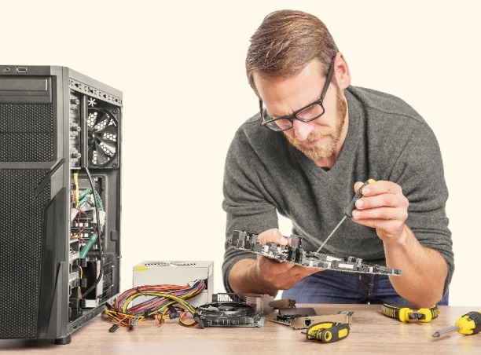
How the Web Works
Web Servers and Browsers
HTML Editors
Basic HTML Elements
Intro to CSS
Intro to JavaScript

Slide 2
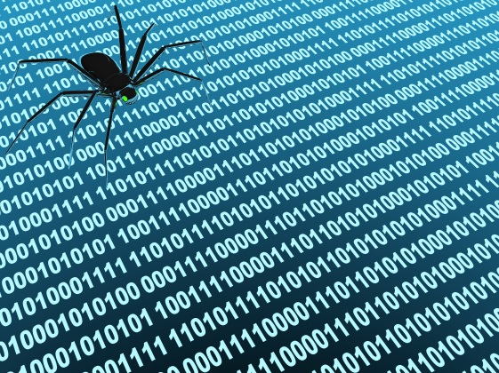
See Also
https://www.youtube.com/watch?v=7_LPdttKXPc
http://www.explainthatstuff.com/howthewebworks.html
https://www.w3schools.com/

Slide 3
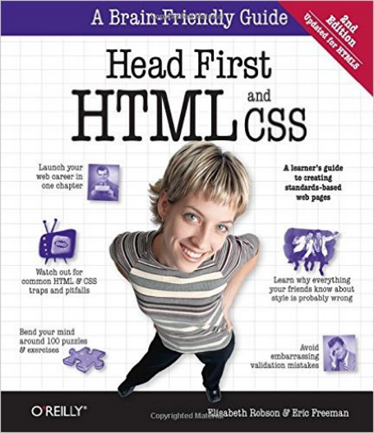
In the Book
Chapter 1:
The Language of the Web

Slide 4
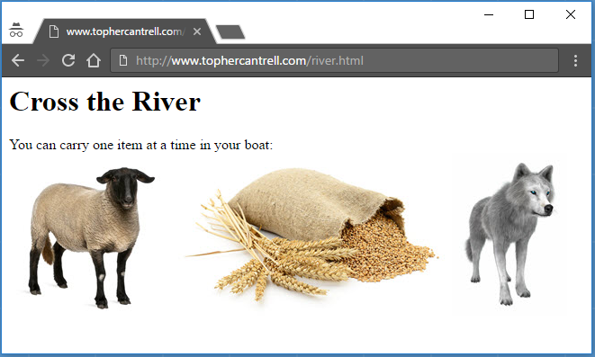
Clients and Servers
http://www.topherCantrell.com/river.html
protocol
(how to talk)
resource
(server address)
path
(file name)
Streams of bytes … two ways (into your program and out of your program)
Disks, consoles, sockets, keyboards, printers
Know how to talk streams and you can talk to anything
Initialization (constructor) is different. Use is the same.

Slide 5
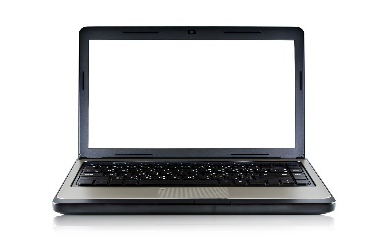
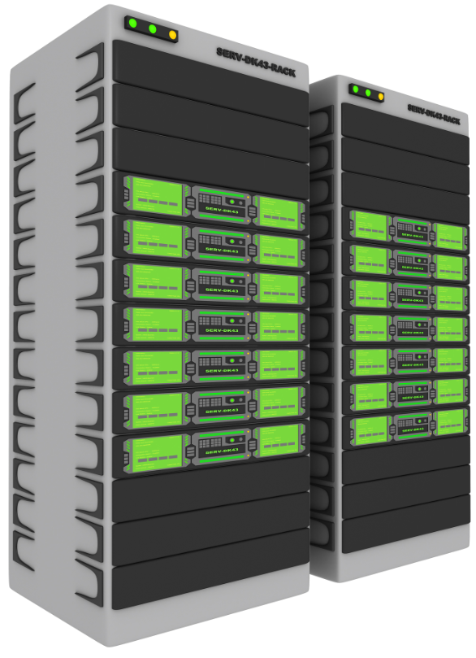
Back and Forth
topherCantrell.com
Browser
Give me “river.html”
Here you go
Give me “sheep.jpg”
<html>
<body>
<h1>Cross the River</h1>
You can carry ... <br>
<img src="sheep.jpg">
<img src="grain.jpg">
<img src="wolf.jpg">
</body>
</html>
Here you go
grain.jpg
wolf.jpg

Slide 6
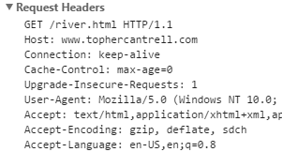
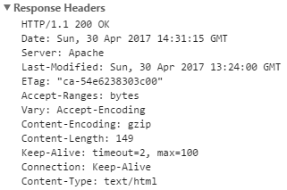
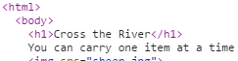
HTTP Traffic
Give me “river.html”
Here you go
Streams of bytes … two ways (into your program and out of your program)
Disks, consoles, sockets, keyboards, printers
Know how to talk streams and you can talk to anything
Initialization (constructor) is different. Use is the same.

Slide 7
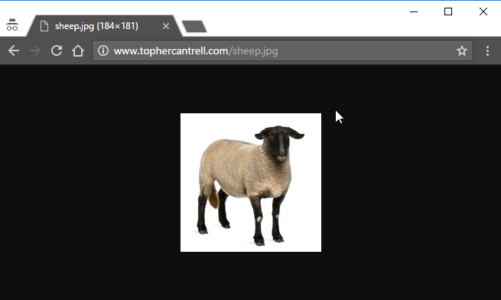
Besides HTML
Put farm.html on comparch
Browser line (http, server, resource)
Packets to and from
Content type in packet
Browser shows different types: text, jpg, html
Show html and network activity
Can open local files ... Uses extension to guess type
Streams of bytes … two ways (into your program and out of your program)
Disks, consoles, sockets, keyboards, printers
Know how to talk streams and you can talk to anything
Initialization (constructor) is different. Use is the same.

Slide 8
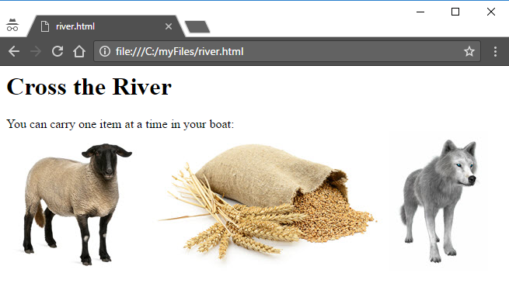
Local Files
Streams of bytes … two ways (into your program and out of your program)
Disks, consoles, sockets, keyboards, printers
Know how to talk streams and you can talk to anything
Initialization (constructor) is different. Use is the same.

Slide 9
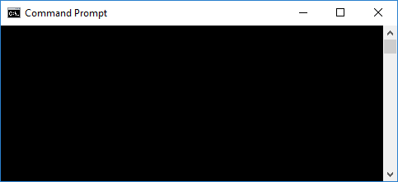
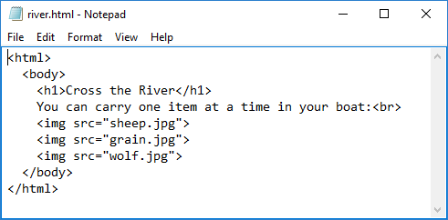
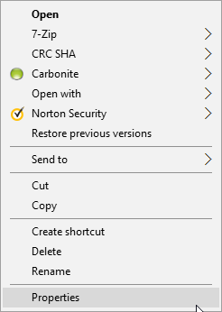
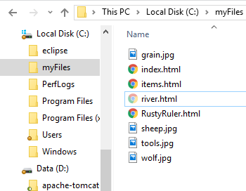
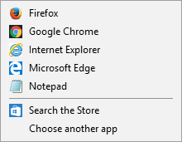
Use Any Text Editor
C:\myFiles>
C:\myFiles>
notepad river.html
river.html
Streams of bytes … two ways (into your program and out of your program)
Disks, consoles, sockets, keyboards, printers
Know how to talk streams and you can talk to anything
Initialization (constructor) is different. Use is the same.

Slide 10
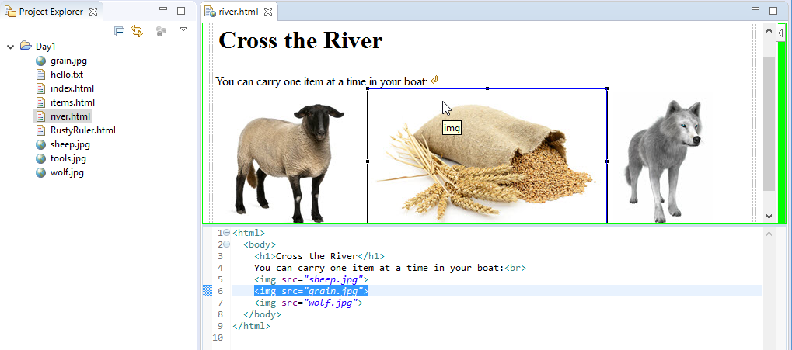
IDE (Like Eclipse)
Streams of bytes … two ways (into your program and out of your program)
Disks, consoles, sockets, keyboards, printers
Know how to talk streams and you can talk to anything
Initialization (constructor) is different. Use is the same.

Slide 11
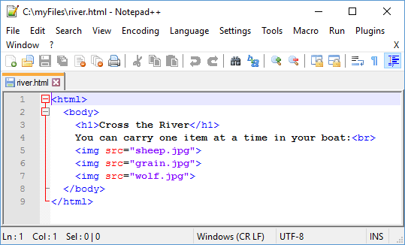
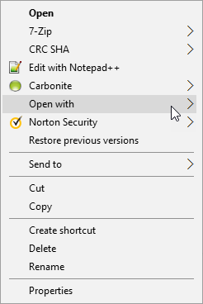
Notepad++
https://notepad-plus-plus.org
C:\myFiles>
notepad++ river.html
Streams of bytes … two ways (into your program and out of your program)
Disks, consoles, sockets, keyboards, printers
Know how to talk streams and you can talk to anything
Initialization (constructor) is different. Use is the same.

Slide 12
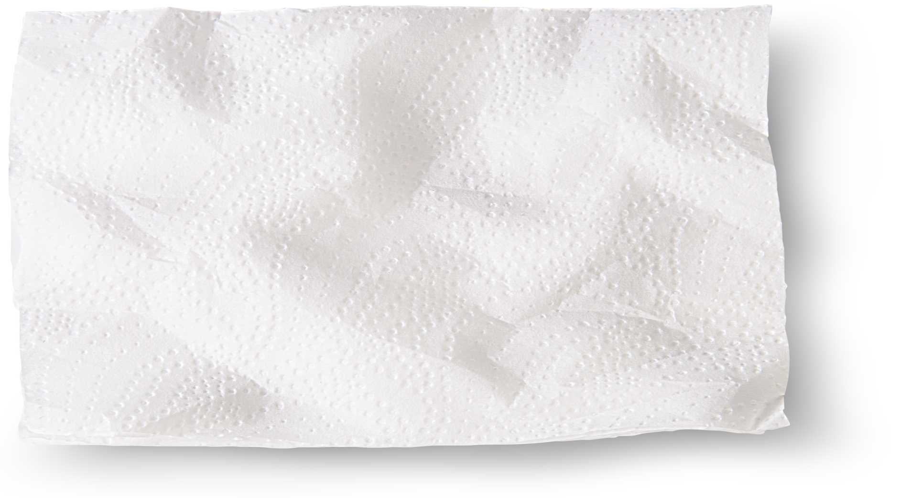
For Sale
Our Items
Pencil, $0.25
Ticonderoga pencils! Simply the best pencil ever made. These beauties come
pre-sharpened and ready to write!
Pen, $0.50
Office Depot brand ballpoint pens. Click to write. Pick your color: red, blue, or black.
Paper, $1.00
One hundred pages of lined, loose-leaf paper. Pick "college" or "wide" ruled.
Notebook, $2.00
Single-subject (80 pages) notebooks. These were selected specially for
Mrs. Davidson's English class. Pick your color: red, blue, or green.
Streams of bytes … two ways (into your program and out of your program)
Disks, consoles, sockets, keyboards, printers
Know how to talk streams and you can talk to anything
Initialization (constructor) is different. Use is the same.
Notes:
Meet up with your buddies over pizza and draw up the plans for a school store. You’ll need a web page.
The menu looks something like this:
Items and their cost
Description of each

Slide 13

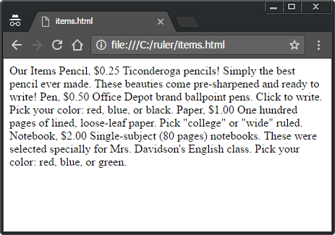
For Sale
items.html
Our Items
Pencil, $0.25
Ticonderoga pencils! Simply the best pencil ever made. These beauties come pre-sharpened and ready to write!
Pen, $0.50
Office Depot brand ballpoint pens. Click to write. Pick your color: red, blue, or black.
Paper, $1.00
One hundred pages of lined, loose-leaf paper. Pick "college" or "wide" ruled.
Notebook, $2.00
Single-subject (80 pages) notebooks. These were selected specially for Mrs. Davidson's English class. Pick your color: red, blue, or green.
Streams of bytes … two ways (into your program and out of your program)
Disks, consoles, sockets, keyboards, printers
Know how to talk streams and you can talk to anything
Initialization (constructor) is different. Use is the same.
Notes:
Use notepad and put that in a text file. Give it the extension “html” so the browser will treat it specially.
Double click and … well not what we wanted.

Slide 14
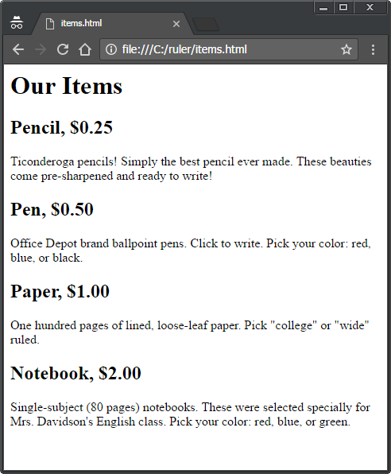
For Sale
items.html
<h1>Our Items</h1>
<h2>Pencil, $0.25</h2>
<p>Ticonderoga pencils! Simply the best pencil ever made. These beauties come pre-sharpened and ready to write!</p>
<h2>Pen, $0.50</h2>
<p>Office Depot brand ballpoint pens. Click to write. Pick your color: red, blue, or black.</p>
<h2>Paper, $1.00</h2>
<p>One hundred pages of lined, loose-leaf paper. Pick "college" or "wide" ruled.</p>
<h2>Notebook, $2.00</h2>
<p>Single-subject (80 pages) notebooks. These were selected specially for Mrs. Davidson's English class. Pick your color: red, blue, or green.</p>
Streams of bytes … two ways (into your program and out of your program)
Disks, consoles, sockets, keyboards, printers
Know how to talk streams and you can talk to anything
Initialization (constructor) is different. Use is the same.
Notes:
We need to tell the browser about the different parts of our information. We add “markup”.
H1 is HEADING ONE
H2 is HEADING TWO … one level deeper under heading one. H3, H4, and so on.
We are NOT telling the browser how to style these … not saying “ok, big font now. Now bold. Now back to regular font.” Instead we are telling the browser WHAT these things are and letting it style them. They might look different on phones or visually impaired.

Slide 15
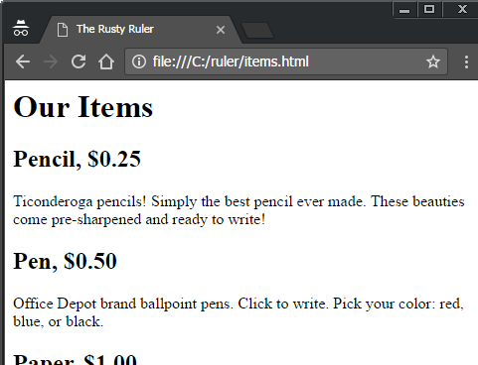
Proper HTML
<html>
<head>
<title>The Rusty Ruler</title>
</head>
<body>
<h1>Our Items</h1>
<h2>Pencil, $0.25</h2>
<p>Ticonderoga pencils! Simply the best pencil ever made. These beauties come
pre-sharpened and ready to write!</p>
<h2>Pen, $0.50</h2>
<p>Office Depot brand ballpoint pens. Click to write. Pick your color: red, blue,
or black.</p>
<h2>Paper, $1.00</h2>
<p>One hundred pages of lined, loose-leaf paper. Pick "college" or "wide" ruled.</p>
<h2>Notebook, $2.00</h2>
<p>Single-subject (80 pages) notebooks. These were selected specially for Mrs.
Davidson's English class. Pick your color: red, blue, or green.</p>
</body>
</html>
Streams of bytes … two ways (into your program and out of your program)
Disks, consoles, sockets, keyboards, printers
Know how to talk streams and you can talk to anything
Initialization (constructor) is different. Use is the same.

Slide 16
Auto-Correct
<html>
<head>
<title>The Rusty Ruler</title>
<BODY>
<h1>Our Items</h1>
<h2>Pencil, $0.25</h2>
<p>Ticonderoga pencils! Simply the best pencil ever made. These
beauties come pre-sharpened and ready to write!</p>
<blah>
<h2>Pen, $0.50</h2>
Office Depot brand ballpoint pens. Click to write. Pick your
color: red, blue, or black.
<h2>Paper, $1.00</h2>
<p>One hundred pages of lined, loose-leaf paper. Pick "college"
or "wide" ruled.
<h2>Notebook, $2.00</h2>
<p>Single-subject (80 pages) notebooks. These were selected
specially for Mrs. Davidson's English class. Pick your
color: red, blue, or green.</p>
</body>
No closing </head>
All caps?
Invalid tag
No <p>…</p>
Missing </p>
No closing </html>
Streams of bytes … two ways (into your program and out of your program)
Disks, consoles, sockets, keyboards, printers
Know how to talk streams and you can talk to anything
Initialization (constructor) is different. Use is the same.

Slide 17
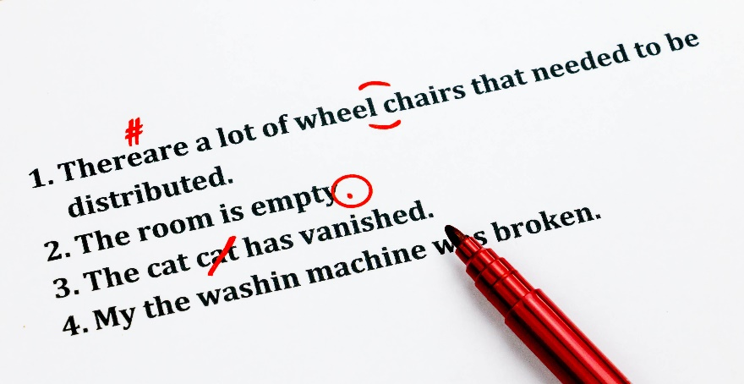
Auto Correct
Browsers will auto-correct the HTML as best they can.
XHTML
Easier on the browser
A lot of legacy HTML
A lot of legacy browser code
HTML5 specification includes a lot of “how to correct” rules.

Slide 18
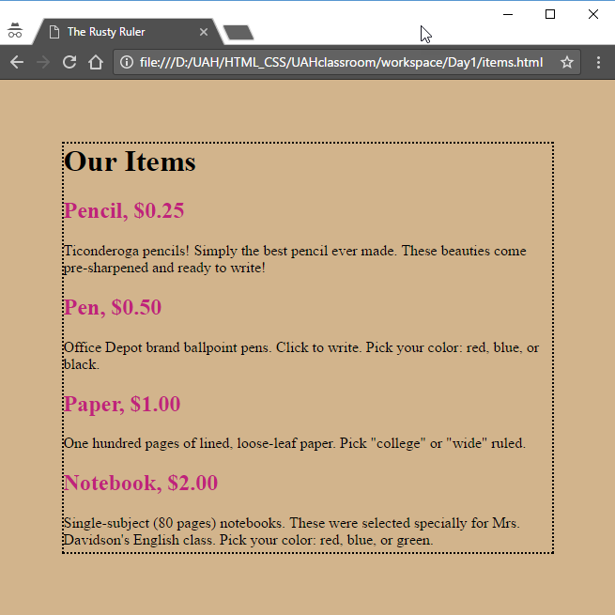
About Style (Later This Course)
<html>
<head>
<title>The Rusty Ruler</title>
<style>
body {
background-color: #d2b48c;
border: 2px dotted black;
margin: 10%;
}
h2 {color: #C0227B;}
</style>
</head>
<body>
<h1>Our Items</h1>
<h2>Pencil, $0.25</h2>
<p>We have Ticonderoga pencils! </p>
...
</body>
</html>
The <style> goes in the <head>
You can have multiple <style> tags
Controls presentation of various elements
Streams of bytes … two ways (into your program and out of your program)
Disks, consoles, sockets, keyboards, printers
Know how to talk streams and you can talk to anything
Initialization (constructor) is different. Use is the same.

Slide 19
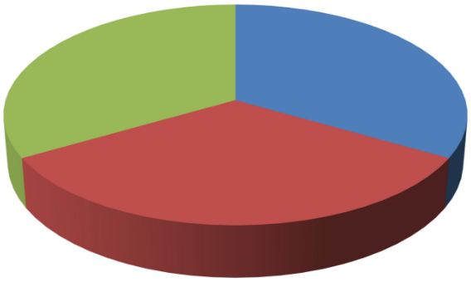
Web Trifecta
Presentation
Structure
CSS
HTML
JavaScript
Dynamic Behavior
Streams of bytes … two ways (into your program and out of your program)
Disks, consoles, sockets, keyboards, printers
Know how to talk streams and you can talk to anything
Initialization (constructor) is different. Use is the same.

Slide 20
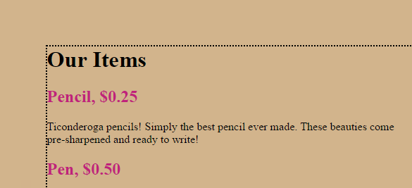
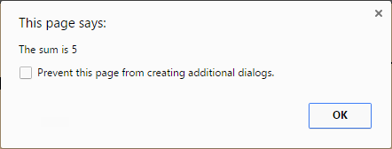
JavaScript (Another Course)
<body>
<h1>Our Items</h1>
<h2>Pencil, $0.25</h2>
<p>Ticonderoga pencils</p>
<h2>Pen, $0.50</h2>
<p>Office Depot brand pens</p>
<script>
var a = 2;
var b = 3;
alert("The sum is "+(a+b));
</script>
<h2>Paper, $1.00</h2>
<p>One hundred</p>
...
</body>
The <script> can appear anywhere in the HTML
There can be multiple <script> tags
JS Program runs in the browser
The code can add, change, and delete elements
The code can talk to the server
Streams of bytes … two ways (into your program and out of your program)
Disks, consoles, sockets, keyboards, printers
Know how to talk streams and you can talk to anything
Initialization (constructor) is different. Use is the same.

Slide 21

Tinkering
Type in the “items.html” example above
Add an image for each item (use the sample images on your desktop)
Add other items for sale from the store

